Slide 1
Everything Everywhere All at Once
The Industrial Transition and the US City
Bruce Katz, Co-Founder and Director, Nowak Metro Finance Lab, Drexel University
April 2023

Slide 2
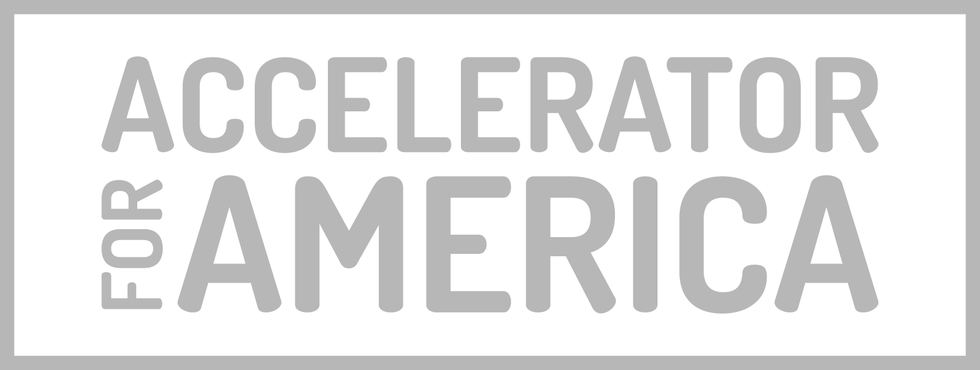
This presentation is built upon the collaborative efforts of the Nowak Metro Finance Lab with The ASPEN Institute Latinos and Society Program in the area of advanced manufacturing, military spending, and the procurement economy as well as with Accelerator for America around the Inflation Reduction Act.

Slide 3
Executive Summary
The US is undergoing a major industrial transition
Market dynamics, geo-political tensions and federal investments are simultaneously driving re-shoring, re-militarization and de-carbonization
Early market signals reveal the promising aspects of this transition, characterized by a surge in public and private spending that is widely distributed across regions, in line with the current dispersed geography of production.
Early market signals also reveal the challenging aspects of this transition:
Industrial sprawl: The boom seems to be characterized by industrial sprawl; many factories are being sited far from employment centers. Cities need to know their starting point and regionally coordinate among these different roles.
Risk of bypassing minority firms: Without intentional strategies to support minority-owned firms, their participation in strategic sectors and supply chains will remain low.
Risk of bypassing minority workers: Without intentional strategies, minority workers will be affected by the job sprawl and the spatial mismatch, as well as the changing labor market.
Cities will be key in shaping these outcomes by performing crucial roles. There are early policy signals of cities leveraging their distinctive strengths through intentional industrial investments and initiatives.
Cities need their own industrial policy
Source: Nowak Metro Finance Lab.

Slide 4
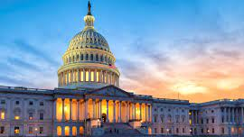
Contents
An Economy in Transition
A Distributed Geography of Production
Upcoming Challenges & The Role of Cities
Early Policy Signals
What comes next?

Slide 5
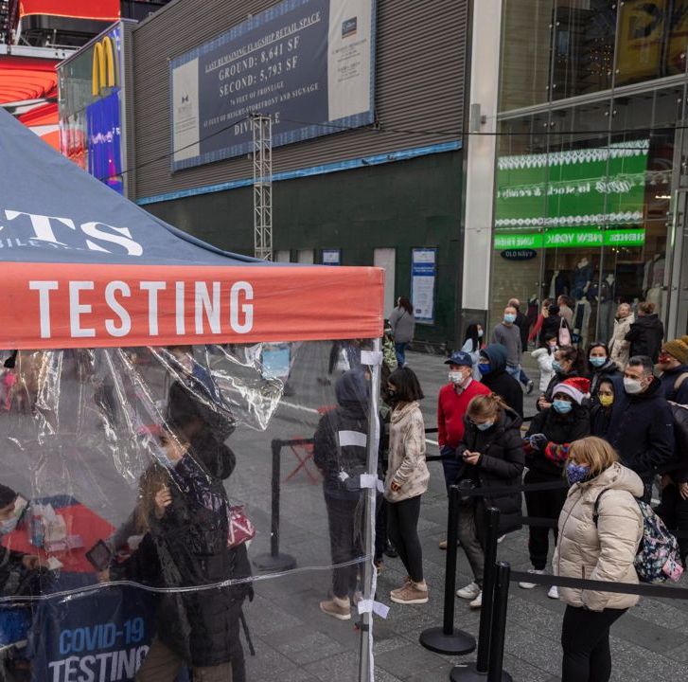
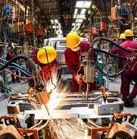
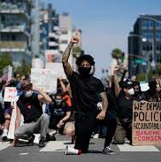
“The New Disorder”
COVID-19 Disruptions
Unprecedented Federal Spending
Inflation & Rising Interest Rates
War in Ukraine
Rising Tensions with China
Renewed Calls for Racial Justice
The Climate Crisis
Remote
Work
“The pandemic, and now geopolitical upheaval, have taken the economy and shaken it up like a snow globe. The flakes will eventually fall – there will be a new equilibrium – but things may be arranged differently when everything settles.”
Jeanna Smialek, New York Times, March 25, 2022

Slide 6
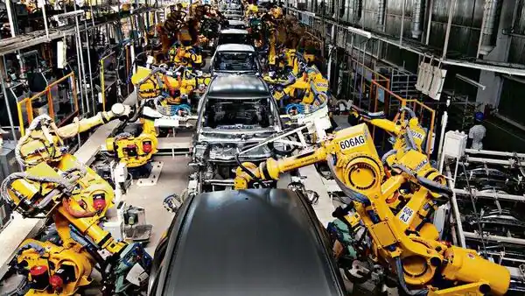
“The Chips act, along with the Inflation Reduction Act and its $369bn in grants and tax credits for the rollout of renewable energy are the most significant attempts to revive industrial policy in the capitalist world since the aftermath of the second world war”
—Anne-Sylvain Chassany
Financial Times, March 5, 2023
“America is accelerating its military containment of China in Asia, rejuvenating old alliances and creating new ones .... In commerce and technology, America is enacting a tough and widening embargo on semiconductors and other goods. The goal is to slow Chinese innovation in order that the West can maintain its technological supremacy: why should America let its inventions be used to make a hostile regime more dangerous?
—The Economist
April 1, 2023

Slide 7
Some of these mega forces have catalyzed a fundamental shift in the prevailing paradigm
Disruptive Mega Forces
Catalysts for change
New Industrial Paradigm
COVID-19
Exposed vulnerability of supply chains
Reshoring
War in Ukraine
Prompt a review of U.S. defense
Remilitarization
Rising tensions with China
Renewed importance of domestic manufacturing
Decarbonization
The climate crisis
Commitment to decarbonize the economy
Sources: The Biden-⁠Harris Plan to Revitalize American Manufacturing and Secure Critical Supply Chains in 2022; Remarks by U.S. Secretary of Commerce Gina Raimondo: The CHIPS Act and a Long-term Vision for America’s Technological Leadership.
Notes:
The United States is pursuing a modern industrial and innovation strategy that includes strategic public investment to protect economic and national security interests.
The strategy includes securing critical infrastructure, advancing foundational cybersecurity, securing supply chains, and using public procurement to stimulate demand for innovation.
The largest investment in physical infrastructure in nearly a century has been enacted, including historic investments in transportation, broadband, clean water, and energy infrastructure.
The semiconductor industry is seen as important to competitiveness and national security, and the CHIPS and Science Act authorizes $280 billion for civilian investment in research and development, especially in critical sectors such as semiconductors and advanced computing.
The National Biotechnology and Biomanufacturing Initiative is investing more than $2 billion to harness the full potential of biotechnology and biomanufacturing, create jobs, strengthen supply chains, and reduce carbon emissions.
The Inflation Reduction Act will invest in domestic energy production and manufacturing, reduce carbon emissions by roughly 40 percent by 2030, and hasten the clean energy transition.
The strategy prioritizes equity and investing in regional economic development to ensure the future is made across all of America, by all Americans.
The US is also protecting its investments and bolstering their resilience through tracking, attributing, and defending against the activities of malicious actors in cyberspace, countering intellectual property theft, and forced technology transfer.

Slide 8
The new paradigm has led to unprecedented federal spending for a competitiveness agenda centered in supply side economics
American Rescue Plan: $1.9T to address the economic and health impacts of the pandemic
Mar 2021
“I will use the term ‘modern supply side economics’ to describe the Biden Administration’s economic growth strategy, and I’ll contrast it with Keynesian and traditional supply-side approaches. [...]
Modern supply side economics, in contrast, prioritizes labor supply, human capital, public infrastructure, R&D, and investments in a sustainable environment. These focus areas are all aimed at increasing economic growth and addressing longer-term structural problems, particularly inequality.”
Bipartisan Infrastructure Law (BIL): $1.2T, the largest investment in physical infrastructure.
Nov 2021
Executive Order 14,017: cabinet agencies have to devise strategies for strategic supply chains.
Feb 2022
CHIPS and Science Act: $280B for R&D, particularly in semiconductors and advanced computing.
Aug 2022
Inflation Reduction Act (IRA): $437B to cut carbon emissions and accelerate the energy transition.
Aug 2022
Janet L. Yellen,
World Economic Forum, Jan 21, 2022
DOD’s 2023 Appropriations bill: $798B to develop, maintain, & equip military forces and intelligence
Sep 2022
Source: Remarks by Secretary of the Treasury Janet L. Yellen at the 2022 'Virtual Davos Agenda' Hosted by the World Economic Forum, January, 2022.

Slide 9
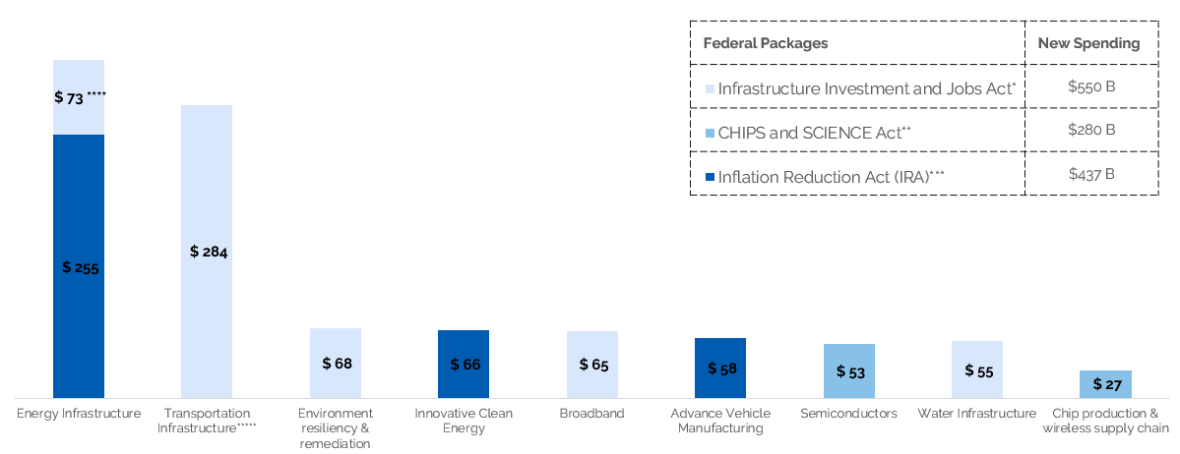
Overall, investments are targeting strategic areas, including energy, transportation, and manufacturing
BIL, CHIPS Act and IRA spending for selected sectors. In billions.
Notes: (*) The BIL allocates an estimated $1.2 trillion in total funding over ten years, but only $550 billion in allocations is new spending during the next five years. (**)This figure includes $200 B allocated for scientific R&D and commercialization initiatives. (***) The IRA is focused on clean energy, making investments across a wide range of sectors, such as energy ($250.6B), manufacturing ($47.7B), environment ($46.4B), transportation and EVs ($23.4B), agriculture ($20.9B),and water ($4.7B). (****) Funds to upgrade power infrastructure and grid automation, including clean-energy technology. (*****) The BIL has funding for roads and bridges; passenger and freight rail; airports, ports, and waterways; public transit; electric vehicles; safety; and reconnecting communities. Source: own elaboration based on The Inflation Reduction Act: Here’s what’s in it, McKinsey; The US Bipartisan Infrastructure Law: Breaking it down, McKinsey; The Inflation Reduction Act: Here’s what’s in it, McKinsey; The CHIPS and Science Act:Here’s what’s in it McKinsey.
Notes:
BY sector:
IRA https://www.mckinsey.com/industries/public-and-social-sector/our-insights/the-inflation-reduction-act-heres-whats-in-it
BIL https://www.mckinsey.com/industries/public-and-social-sector/our-insights/the-us-bipartisan-infrastructure-law-breaking-it-down
Unprecedented Influx of federal infrastructure, innovation, and climate dollars —three major federal packages already in deployment

Slide 10
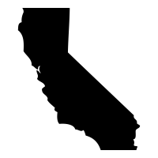
On top of federal programs, several states are making major moves to take advantage of the moment
Aggressive Manufacturing Incentives
New Centers of Excellence
Regional Economic Development
Detroit Center of Innovation, Michigan Central, and Wayne State: $100M each to advance research, innovation, and entrepreneurship
Intel in Ohio: $1B+ incentives for Intel’s new plant in Licking County (job creation tax credit; roads, sewage, and water projects)
Micron in New York: $10B Green CHIPS Bill to attract big manufacturers to the state
California Economic Resilience Fund: $500M Community Economic Resilience Fund for regional economic strategies
Connecticut Innovation Corridor: $100M for regional economic clusters
Indiana Regional Economic Acceleration & Development Initiative: $500M for regional strategic investments
Source: New Localism Associates.

Slide 11
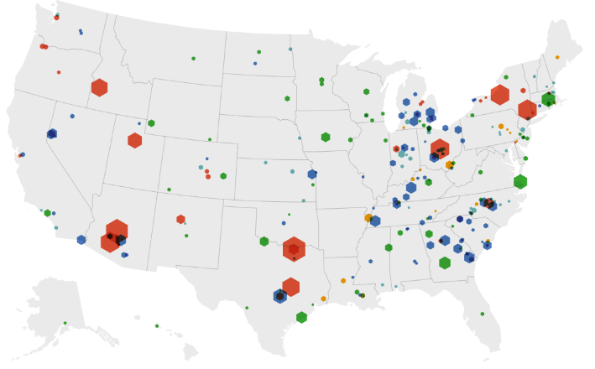
This economic transition is already sending early market signals
Opportunities
A HIGHLY DISTRIBUTED MANUFACTURING BOOM
The boom in private and public spending is widely spread across regions, following a decades-long trend of dispersed production in the U.S.
1
Challenges
INDUSTRIAL SPRAWL
2
Major facilities receiving public funding in the last two years are emerging in suburban and rural towns.
Private investment during current administration in selected industries.
SPATIAL MISMATCH
3
Manufacturing jobs disperse away from city centers
MINORITY FIRM UNDERREPRESENTATION
4
Minority-owned firms' participation in strategic sectors is concerningly low
SKILLED WORKFORCE SHORTAGE
5
Manufacturers increasingly have difficulty filling middle-skill jobs

Slide 12
There are early policy signals of cities and metros leveraging their distinctive strengths through intentional industrial investments and initiatives
 | 1 | 2 | 3 | 4 | 5 | 6 | 7 | 8
Goal | Matching funding to worthy projects | Prepare sites for mfg | Upgrade Capacity/ Technology | Ensure long-term economic competitiveness | Preparing for the ongoing talent shortage | Securing opportunities for small, diverse firms | Upgrade Logistics | Unlock the full ecosystem
Tool | Investment Playbook | Assembly and Remediation | Industry 4.0 | Applied Research | Workforce Development | Supplier Development | Infrastructure | Industry Hubs
Example | Industrial playbook in Flint, MI | Port Authority Industrial Revitalization in Cincinnati, OH | Mfg Readiness Grants in Indianapolis, IN | Advanced Manufacturing Innovation Center in St. Louis, MO | Northland Workforce Training center in Buffalo, NY | Aerospace and Defense Manufacturing coalition in El Paso, TX | Offshore Windport in Rhode Island | Aerospace and Defense Cluster in Wichita, KS
Source: Nowak Metro Fiance Lab & New Localism Associates.

Slide 13
Contents
An Economy in Transition
A Distributed Geography of Production
Upcoming Challenges & The Role of Cities
Early Policy Signals
What comes next?
Notes:
This section should focus on the distributed nature of industrial production — which is a good thing

Slide 14
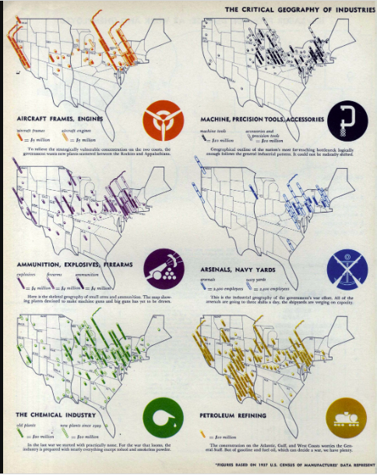
U.S. industrial geography has a long tradition of being shaped by national security concerns
1940 Fortune magazine poster of the geography of wartime production
"It is the policy of the United States that... in order to ensure productive capacity in the event of an attack on the United States, the United States Government should encourage the geographic dispersal of industrial facilities in the United States to discourage the concentration of such productive facilities within limited geographic areas that are vulnerable to attack by an enemy of the United States."
US Congress (1950) -
Defense Production Act
Notes:
https://clustermapping.us/

Slide 15
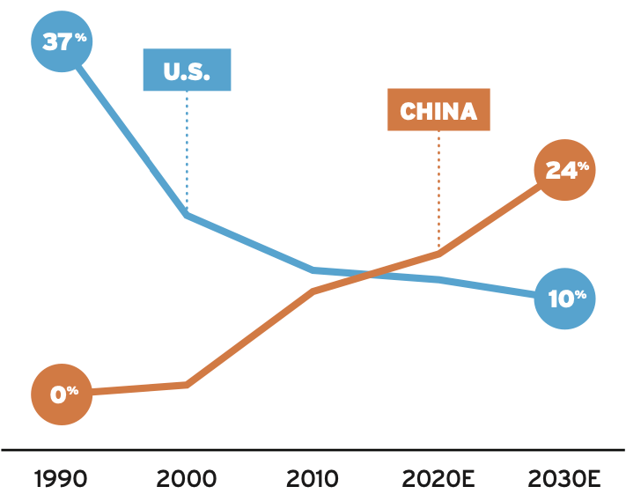
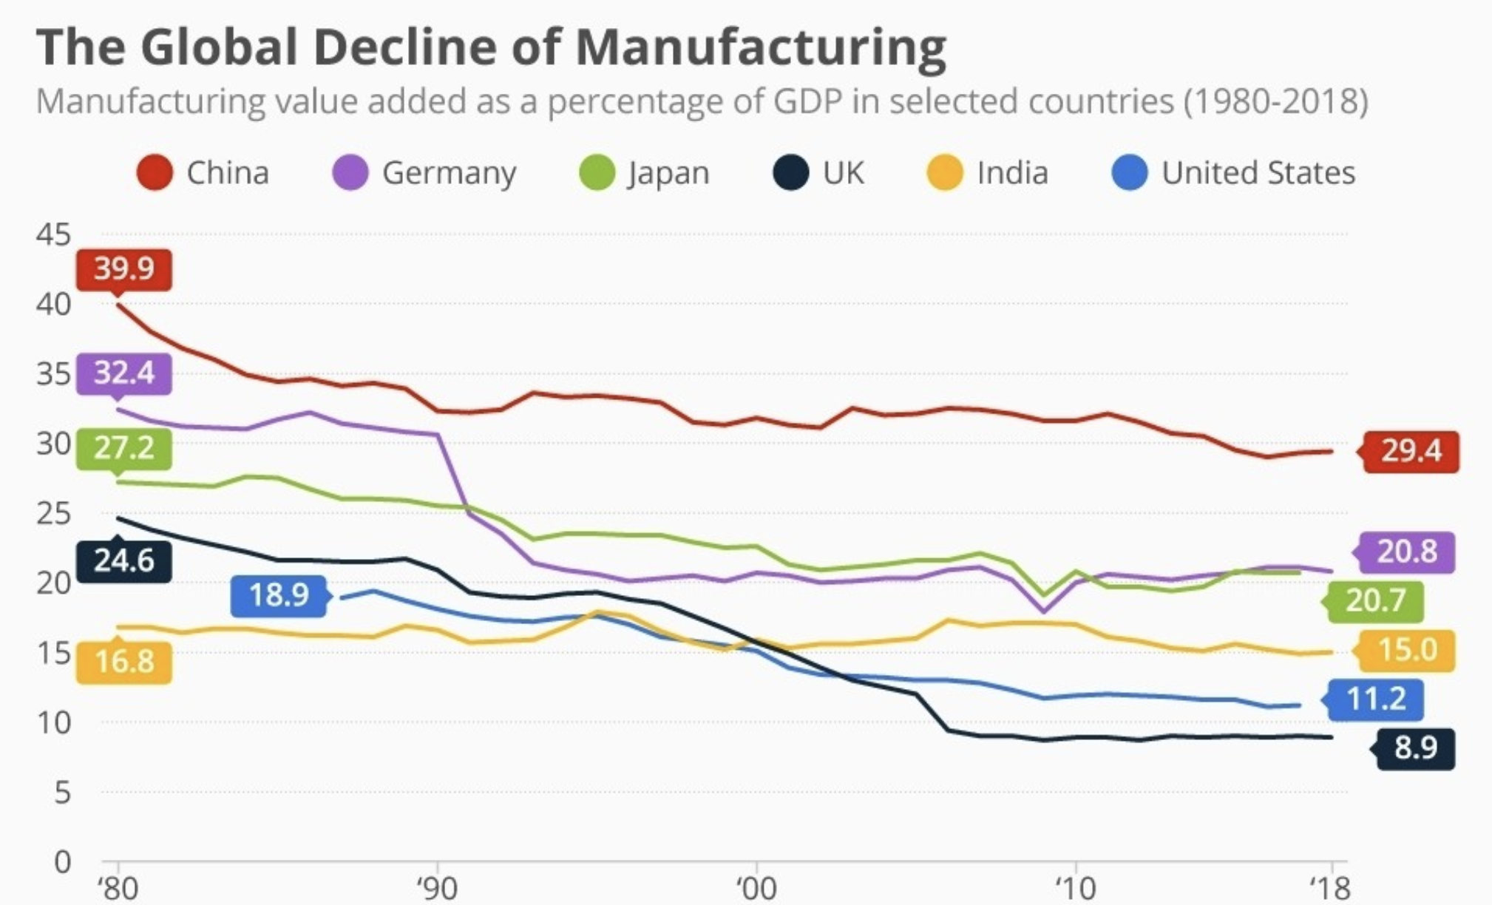
Share of global semiconductor manufacturing, 1990-2030.
Manufacturing value added as % of GDP in selected countries. 1980-2018.
The U.S. manufacturing position has declined in recent decades, especially in the semiconductor industry
Manufacturing sectors in emerging and advanced economies are declining and becoming less important for national incomes.This share is particularly low for the U.S., starting at only 18.9% in the mid 80s and reducing to only 11.2% by 2018.
Source: SIA 2020- America’s Future is Built on Semiconductors.
The U.S. is losing ground to Asian rivals in chip product development, specifically in processing technology and fab capacity. China in particular has a significant semiconductor agenda supported by $150 billion in funding with a fab capacity that has grown from 3% in 2000 to 15% in 2020, surpassing the U.S
Source: The global decline of manufacturing, World Economic Forum, December 2019,

Slide 16
Even today, high-tech manufacturing hubs scatter across metros
Metros with high specialization employment in advanced manufacturing industries
The locational differences between high-technology industries suggest that the industries have very different skill, R&D, or supply chain needs that keep them apart.
High-technology manufacturing specializations are scattered in different regions:
51 MSAs specialize in IT,
31 in Automative 12 in Aerospace & Defense.
Cluster/
Aerospace & Defense
Automotive
IT
Total MSAs
12
31
51
Notes: For metros specialized in more than one industry (four in total), the industry with the highest location quotient was selected
Source: Nowak Metro FInance Lab with data from U.S. Cluster Mapping Project, Institute for Strategy and Competitiveness, Harvard Business School.
Notes:
https://clustermapping.us/

Slide 17
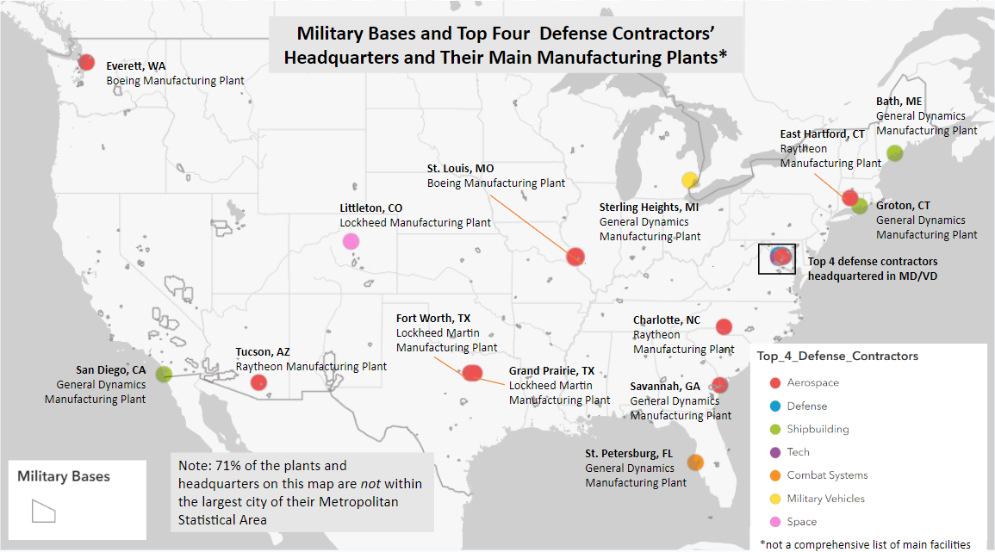
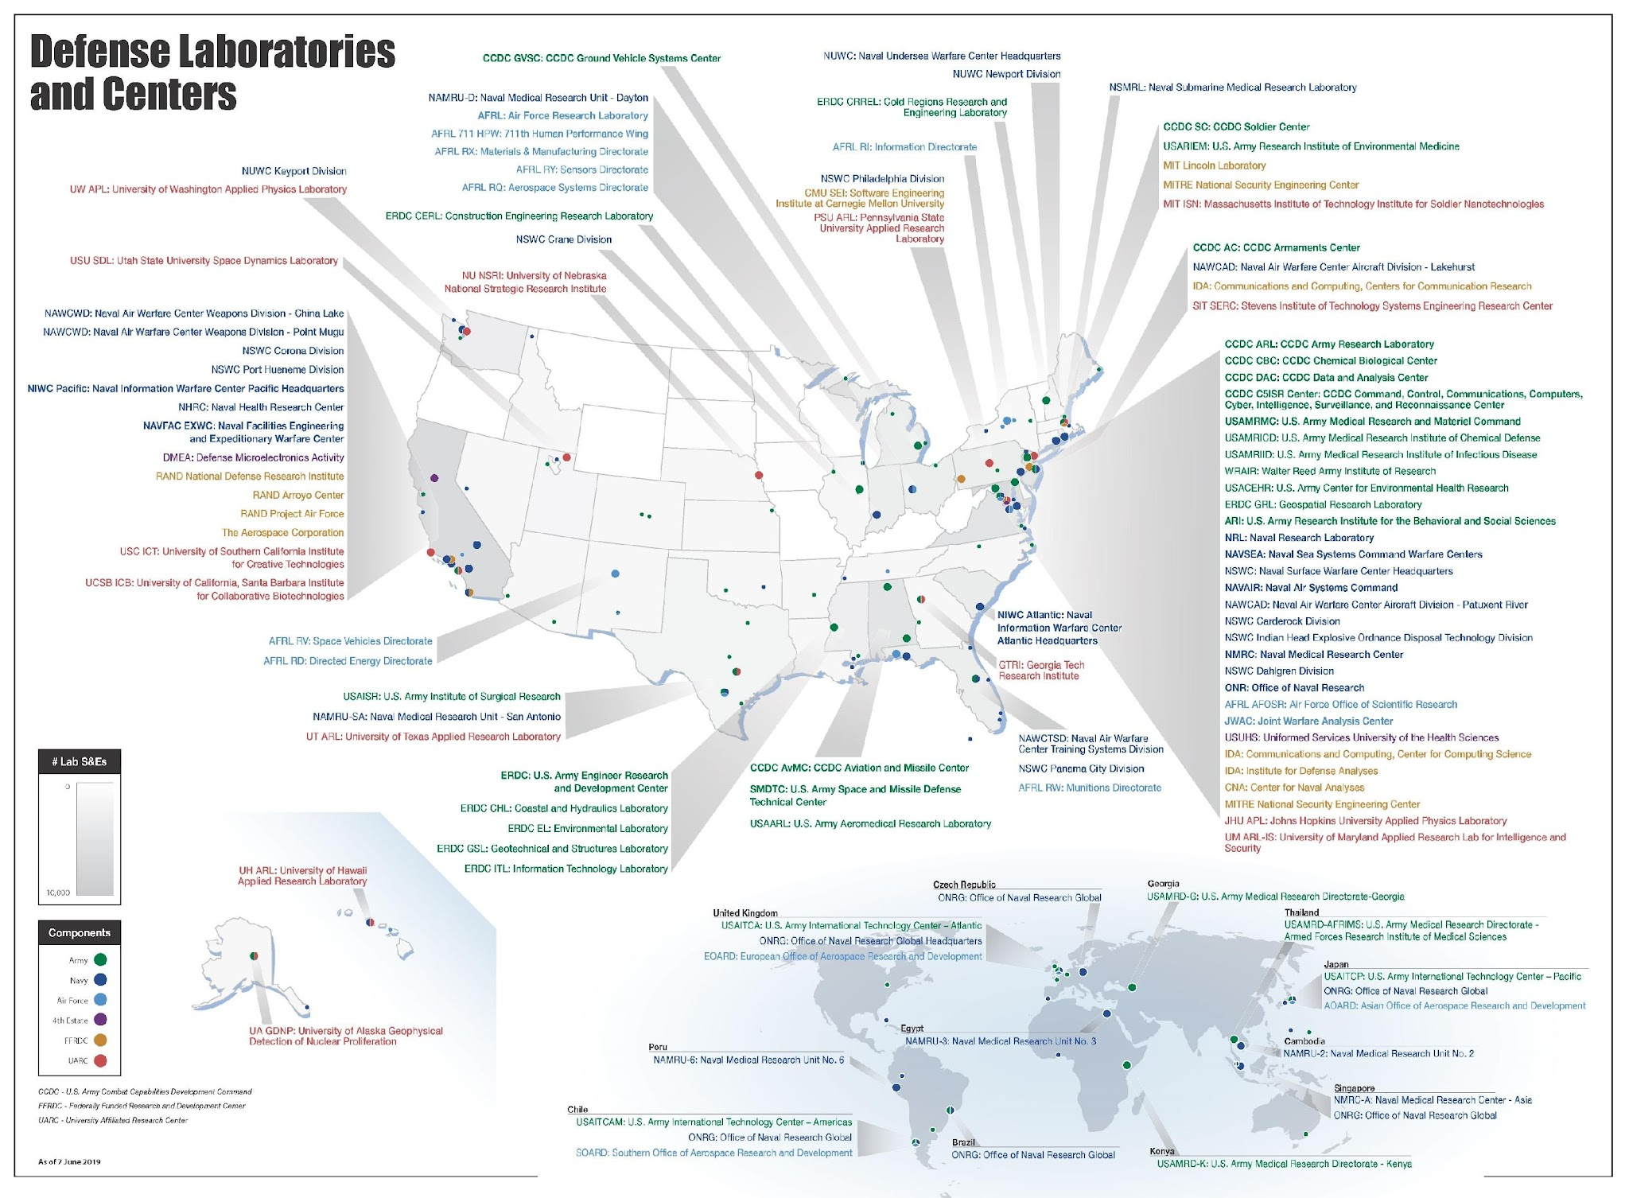
The geographical distribution of military production follows a similar pattern with bases, contractors, and strategic assets situated from coast to coast
Military bases and top contractor headquarters are dispersed beyond major cities, with a significant portion located in smaller cities and towns
Strategic assets for industrial activities, such as R&D labs and centers, accompany the distributed geography of production in the U.S.
Top Defense Contractors HQs an their main MFG plants
Source: Military Base map created at Nowak Metro Finance Lab; Defense Labs map is from the Department of Defense
Notes:
https://clustermapping.us/

Slide 18
Unsurprisingly, private investments are reinforcing the existing pattern of industrial dispersion across the country
Private investment during current administration in selected industries.
Public investments via IRA and CHIPS have spurred private sector investments of over $435 billion in 240+ projects nationwide.
These investments concentrate in industries that will boost U.S. competitiveness, strengthen supply chains, and help build a clean energy economy:
+$200B in Semiconductors & Electronics
+$200B in Clean Energy and Evs & Batteries
+$15B in Biomanufacturing
+$1B in Heavy industry
Source: White House. (n.d.). Retrieved from https://www.whitehouse.gov/invest/

Slide 19
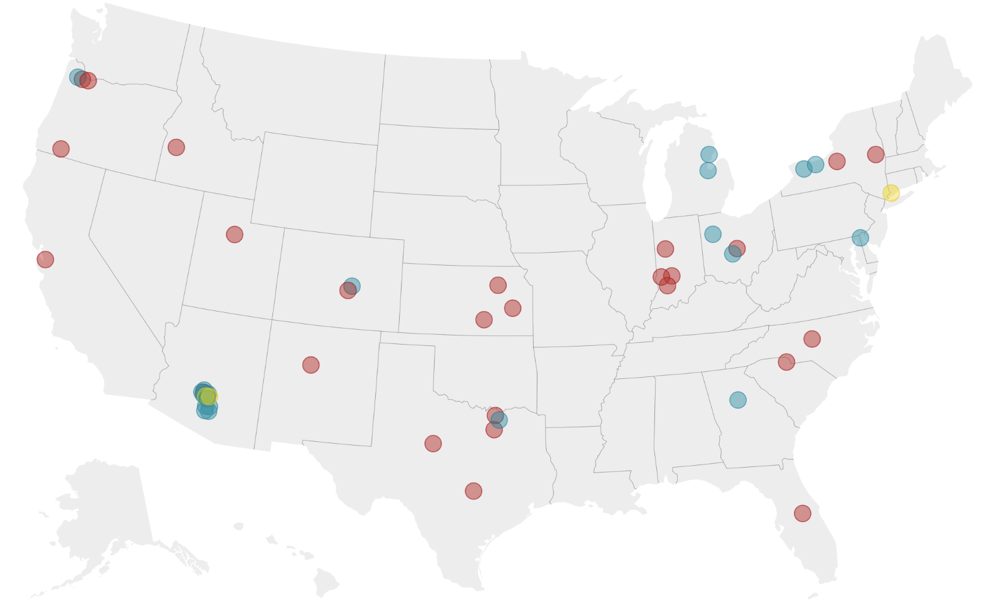
Private investments to boost U.S. manufacturing capacity in the semiconductor supply chain have been predominantly focused on 5 states
Semiconductor supply chain manufacturing investments. May 2020-January 2023.
Semiconductor industry supply chain investments:
Led by a few, very large projects related to Chip Fabs Construction/Expansion, and Tooling/Equipment/Materials Upgrades and Investments.
Arizona, Texas, New York, Ohio, and Indianapolis account for 85% of semiconductor supply chain manufacturing investments.
Positive Impact:
44,000 new high-quality jobs created
Approximately +250K jobs supported in the wider U.S. economy
 | Category | Investment | Jobs | Projects
 | Equipment | $228 | 1,100 | 3
 | Materials | $9,483 | 4,531 | 21
 | Semiconductors | $200,728 | 33,013 | 27
Source: The CHIPS Act Has Already Sparked $200 Billion in Private Investments for U.S. Semiconductor Production, Semiconductor Industry Association, 2022.
Notes:
https://twitter.com/baldwinbiogas/status/1642197578686054400
Looking from Europe we see low gas price as the key to investment. It seems inconceivable to make batteries in most of Europe, at best we can put stickers on them…
To complement this slide https://www.whitehouse.gov/invest/
Over $435 billion in private sector investments across the country, representing over 240 projects
Over $200 billion for clean energy, electrical vehicle, and battery projects, over $200 billion for semiconductor-related projects, and over $15 billion in critical biomanufacturing projects.
Investments in semiconductor-related projects are impressive. Looking at the map, those investments are led by a few, very large projects. Texas, Arizona, New York, and Ohio have captured most investments so far.
As for investments in the other sectors (clean energy, EVs & batteries, heavy industry, and biomanufacturing), they tend to be smaller are more geographically dispersed (the more concentrated of these sectors is EVs & batteries). This may offer some hints in terms of the opportunities for metros.
The map does not include many investments under $100M

Slide 20
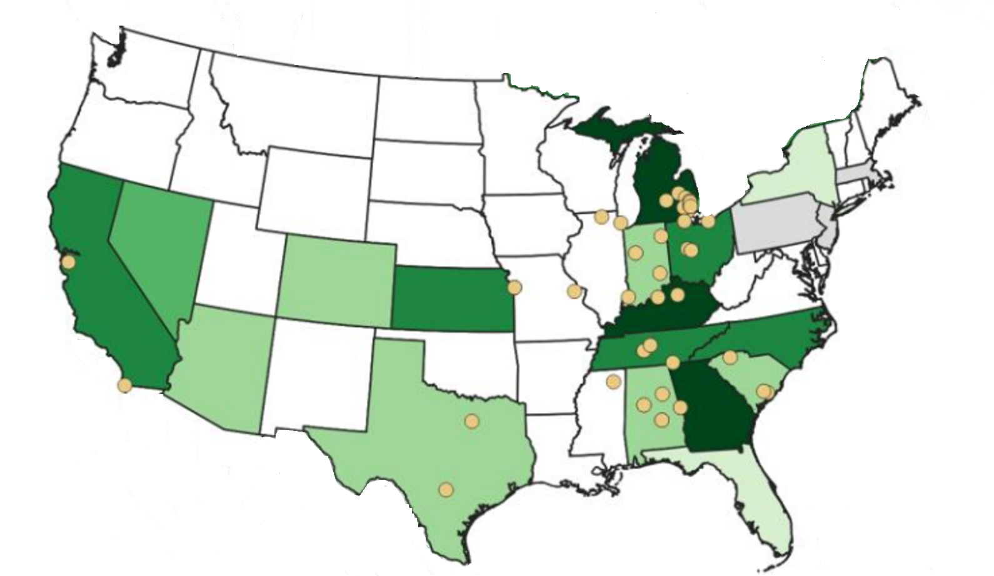
For EVs and batteries, investments to boost domestic manufacturing concentrate along a north-south band from Michigan to Alabama
Planned battery plant capacity in the U.S. by 2030.
DOE's investments in R&D have driven domestic battery manufacturing and supply chain investments, reaching a total of $90B and creating over 60K jobs.
To optimize supply chain logistics, many battery plants will co-locate with automotive plants, concentrated along a north-south band from Michigan to Georgia.
Kentucky, Tennessee, Georgia, and Michigan will see the highest growth in battery mfg capacity, with Ford, SK Innovation, and LG Energy Solutions investing in these areas.
Source: North American Lithium-Ion Battery Manufacturing Capacity and Supply Chain Analysis, Argonne National Laboratory. Investments in American-Made Energy, U.S. Department of Energy.

Slide 21
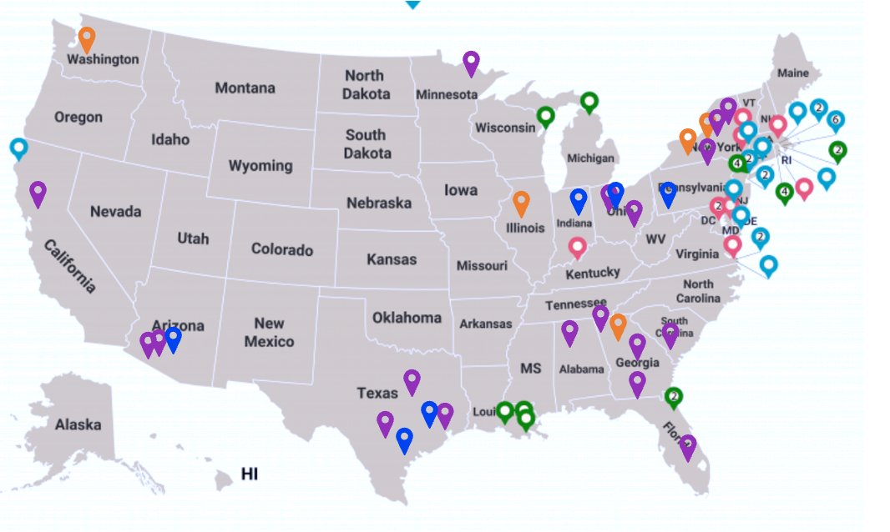
Clean energy mfg investments in offshore wind concentrate on the East Coast, while CA, AZ, and TX play a significant role in solar panel production
Solar manufacturing:
Over $5B in investments announced so far;
50 manufacturing plants (just 30 in the map).
Offshore wind manufacturing and port investments:
Nearly $3.5B in in investments;
11 manufacturing facilities and 13 ports;
17 new vessels being built in 7 different states.
Solar & offshore wind manufacturing, port and vessel investments announced under President Biden.
Source: Investments in American-Made Energy, U.S. Department of Energy.

Slide 22
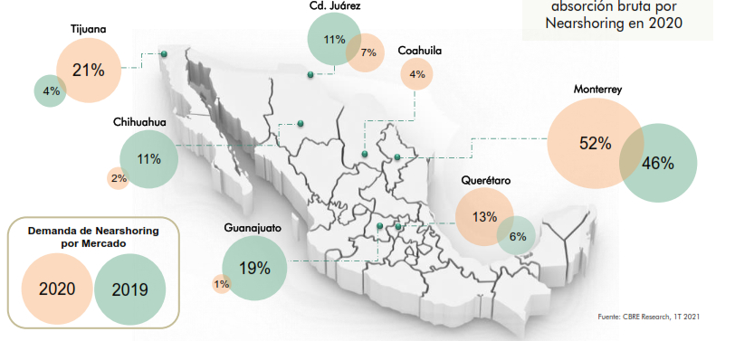
Nearshoring demand by market, 2019 vs 2020.
Amidst escalating tensions, securing supply chains through nearshoring is emerging as a viable solution for the BOTH the US and China
The COVID-19 pandemic, the trade war between the U.S. and China, and the implementation of the USMCA have made of Mexico a strong contender for nearshoring.
From 2019 to the first quarter of 2021, 69 companies have arrived in Mexico:
66% of nearshoring comes from the US, The Mexican border states have become the most attractive market for nearshoring in Mexico, with 60% of occupied space in 2020,
However, 34% of nearshoring comes from Chinese companies. Chinese companies invest in Mexico to take advantage of the North American trade deal, following a trend of nearshoring to establish factories for duty-free access to the U.S. market, mitigating shipping and geopolitical risks.
Nearshoring demand by Market
Source: CBRE. "69 Empresas han llegado por Nearshoring en la era T-MEC." Cluster Industrial.

Slide 23
Contents
An Economy in Transition
A Distributed Geography of Production
Upcoming Challenges & The Role of Cities
Early Policy Signals
What comes next?

Slide 24
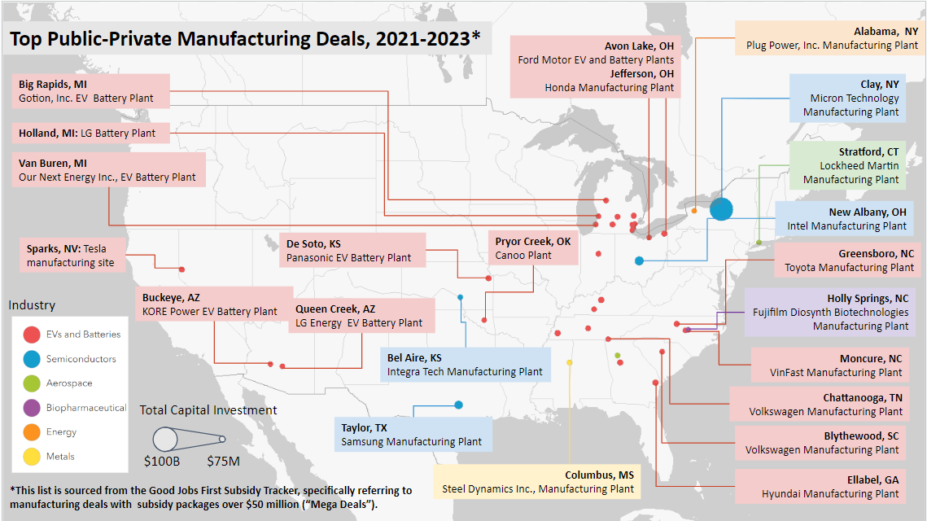
Challenge 1: The manufacturing boom is highly distributed, lending itself to industrial sprawl beyond urban centers.
Major facilities receiving public funding in the last two years are emerging in suburban and rural towns. Most of the plants (95%) on this map are not within the largest city of their Metropolitan Statistical Area. This leads to facilities being far from suppliers, universities and other anchors
Industry Sprawl Challenges
Facilities far from suppliers
Facilities far from universities and other anchor institutions
*Source: Nowake Metro Finance Lab with data from Good Jobs First

Slide 25
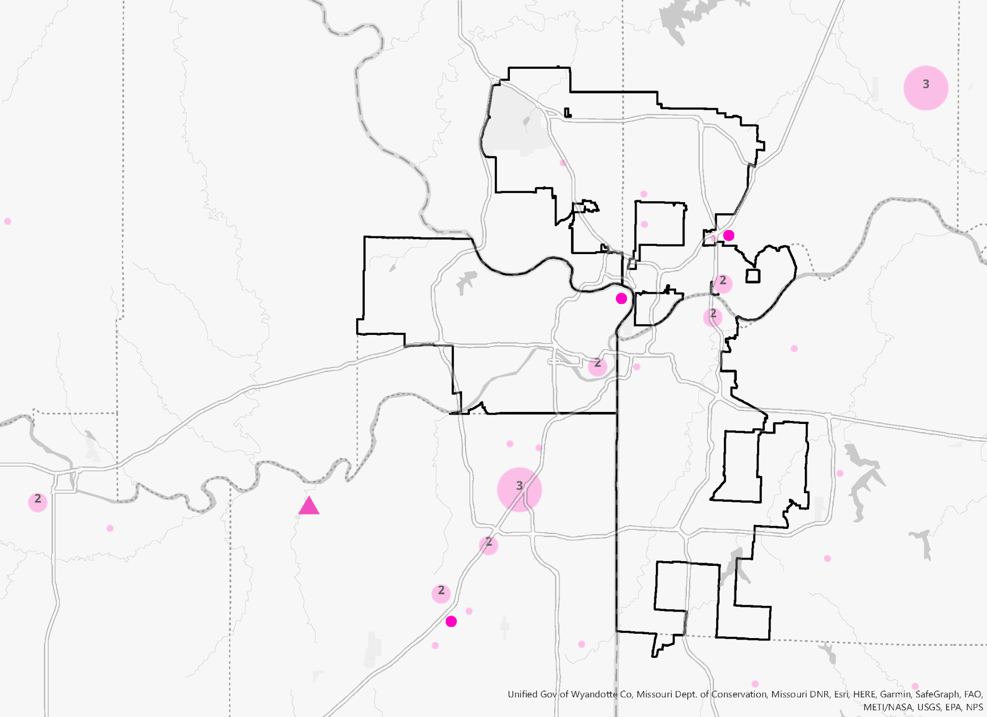
While big manufacturing plants are in the suburbs, supply chain firms are highly distributed
In the Kansas City area, EV manufacturing firms are dispersed beyond city limits. The new Panasonic Energy EV battery manufacturing in De Soto, KS, contributes to this sprawl.
Role for cities : Attracting suppliers
Optimizing site readiness: acquisition, demolition, and site preparation of sites for business retention and expansion
Upgrading logistics to provide efficient supply chain management.
These efforts aim to create a network of interdependent suppliers and manufacturers, which can lead to increased productivity, reduced costs, and a more robust regional economy.
The Ford Kansas City Assembly Plant has been operating in Claycomo, MO since 2010, employing over 7,000 employees.
2022 Panasonic Energy to invest $4B in a EV battery plant in De Soto, KS in 2022.
The GM Fairfax Assembly Plant operates in Kansas City.
3
Number of EV
Manufacturing Firms*
2022 Garmin Ltd to expand their plant in Olathe, KS
2
Key Auto Manufacturing Plants
Kansas City, KS and Kansas City, MO Boundaries
*Source: Nowak Metro Finance Lab/ Data Axle 2023, “EV Manufacturing Firms” defined as NAICS codes 3361, 3362, 3363, 335312, 335910

Slide 26
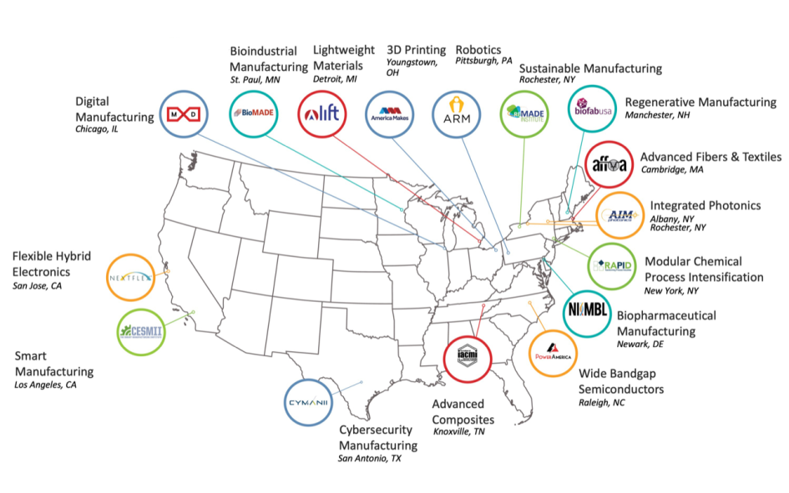
Unlike manufacturing, R&D assets tend to concentrate in the center of cities
DOD’s Manufacturing Innovation Institutes (MIIs):
67% of them are within the largest city of their MSA
Role for cities : Ground dispersed industries
Cities must position themselves as the leading centers for next-generation industry clusters. by evaluating and leveraging their unique urban assets:
Labor supply: skilled workers
R&D: Universities, Centers of Excellence, labs/
Public Infrastructure: Airports, ports, highways, energy grids
Industrial Infrastructure: manufacturing facilities, transportation and logistics
By uniting stakeholders from gov, industry and academia, MIIs across the US serve as game-changing catalysts that connect and ground innovative industrial ecosystems with emerging technology and market sectors in the United States.
Source: Department of Defense. DoD Public-Private Partnerships Focus on Manufacturing Innovations to Fight COVID-19 and Build the Industrial Base.
Notes:
https://clustermapping.us/

Slide 27
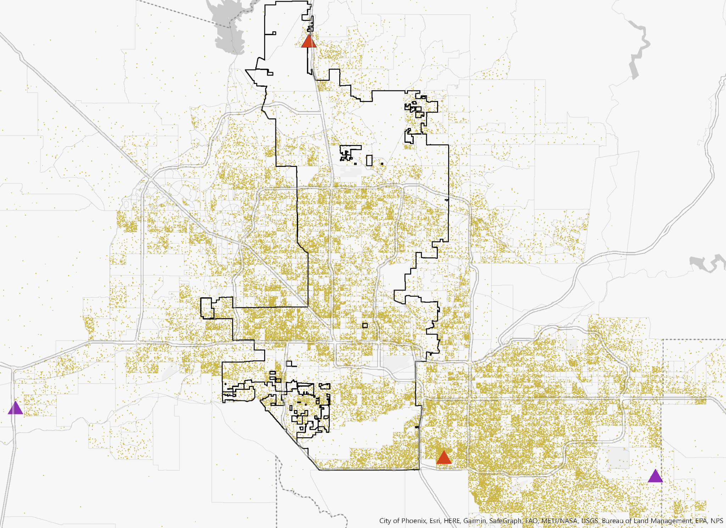
Challenge 2: Spatial Mismatch- Manufacturing jobs disperse away from city centers limiting job access for urban residents
In Phoenix for example, the distribution of manufacturing jobs sprawl beyond city limits, a trend that will only continue as major facilities develop in suburban and rural areas.
Spatial Mismatch Challenges
2022- Taiwan Semiconductor Manufacturing Co. to spend $26B in for 2 plants
Workers facing long commutes
Legend
EV and Battery Manufacturing Plant Announcements
2021- $1.25B battery mfg plant from KORE Power in Buckeye
Semiconductor Manufacturing Plant Announcements
2022-Intel investing $20B into their facilities Chandler, AZ.
City of Phoenix Limits
Training centers far from minority workers
1 Dot = 3 Manufacturing Jobs (2020 LODES data)
2023- $5.5B from LG Energy Solutions for EV battery manufacturing in Queens Creek, AZ.
Source: Nowak Metro Finance Lab; Data on manufacturing jobs from 2020 LEHD Origin-Destination Employment Statistics; Plant sites identified from Good Jobs First Subsidy Tracker

Slide 28
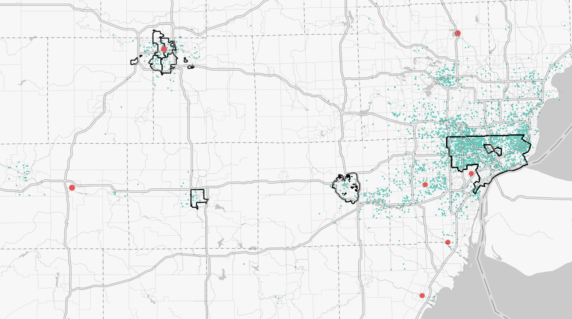
Metros characterized by higher spatial mismatch are also characterized by greater spatial mismatch for Blacks workers
Where Black Workers Live and Top Public-Private Manufacturing Deals in Central Michigan
Role for cities: Coordinating with suburbs and the region
Through collective strategies such as promoting transit- oriented development (TOD) and coordinating land use planning, cities can foster the development of transit hubs, help distribute development evenly throughout the region, reduce commute times and improve access to job opportunities.
Dearborn, MI
Ford Motor Manufacturing Plant
Marshall, MI
Ford Motor EV Battery Plant
Lansing and Lake Orion, MI
General Motors EV and Battery Plants
Lansing
Detroit
Wayne, MI
Ford Motor Manufacturing Plant
Ann Arbor
Flat Rock, MI
Ford Motor Manufacturing Plant
Jackson
City Proper Borders
Monroe, MI
Ford Motor Manufacturing Plant
1 Teel Dot = 150 Black Workers, aged 16+
*This list of manufacturing deals is sourced from the Good Jobs First Subsidy Tracker, specifically referring to manufacturing deals with subsidy packages over $50 million (“Mega Deals”).
**Data for Employment Density: U.S. Census Bureau. 2023. LEHD Origin-Destination Employment Statistics (2002-2020). Washington, DC: U.S. Census Bureau, Longitudinal-Employer Household Dynamics Program [distributor], accessed on April 2023 at https://onthemap.ces.census.gov.

Slide 29
Challenge 3:Minority-owned firms' participation in strategic sectors is concerningly low
The gap is particularly concerning for Black-owned businesses which represent no more than 1% of all employer firms in construction, manufacturing and utilities
Asian
Latino
Black
Construction
14,169
2%
50,187
7%
8,218
1%
Total U.S. Employer Firms: 706,354
Manufacturing
11,632
5%
10,504
4%
1,608
<1%
Total U.S. Employer Firms: 251,707
This couples with data from the U.S. Small Business Administration reflecting that federal contracting with Black and Latino-owned small businesses was abysmally low in 2021, at less than 4%,
Utilities
56
<1%
101
<1%
18
<1%
Total U.S. Employer Firms: 6,088
Source: U.S. Census Annual Business Survey 2018, Characteristics of Businesses
* Represents ownership among American Indians, Alaska Natives, Native Hawaiians, and other Pacific Islanders

Slide 30
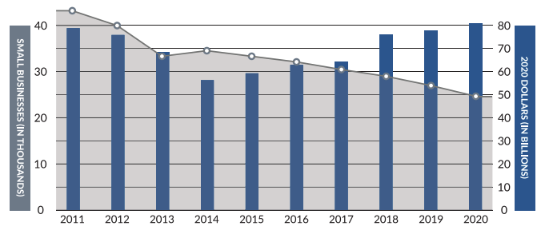
The vulnerabilities exposed by megaforces pose a particular threat to small biz, intentional support is needed to prevent the gap from widening
Although the Department has achieved its small business prime contracting goal for the past eight years, the number of small business participating in the defense industrial base has declined by over 40 percent in the past decade.
DOD’s 2023 Small Business strategy outlines strategic objectives to expand and strengthen its relationship with small businesses and leverage their capabilities
Role for cities : Supplier Development Strategies
Cities must coordinate and scale services to help minority-owned firms overcome the barriers they face to accessing strategic supply chains and public contracting opportunities:
Providing access to capital
Mentorship and training programs
Fostering partnerships and collaborations
Scaling local agency best practices
DOD contract obligations to small businesses
Source: DOD Small BUsiness Strategy 2023

Slide 31
Are diverse businesses in the green infrastructure and utilities sectors ready? Most of them are not (high capital intensity)
Transportation and buildings, followed by utilities industry clusters represent near term priorities given significant funding across the sectors from BIL and IRA., BIPOC business representation, Market size and growth & Industry cluster supports
 | Proposed Tier 1 Priorities |  | Proposed Tier 2 Priorities
 | Transportation | Buildings | Water | Power | Consumer | Oil, Gas, and Fuels | Agriculture and Land Use | Waste | Industrials | Carbon Management
Addressable market size* | $2.3-2.7T | $1.3-1.8T | $1.1-1.2T | $1.0-1.5T | $0.9-1.2T | $0.6-1.1T | $0.5-1.1T | $0.3-0.4T | $0.2-0.3T | $0.1-0.2T
Small business participation
Skill transferability
Capital intensity
Illustrative businesses | EV infrastruc-ture installers OEM suppliers Micro-mobility operators | Architects Civil engineers Installers Electricians | Water treat-ment centers Water resource managers | Utility managers Power line technicians Solar panel operators | Light manuf-actuers Packaging engineers / producers | Sustainable fuel / energy producers Energy technologists | Farmers (urban, rural) Foresters Food producers | Materials processors Recyclers Waste managers | Raw material processors Fabricators | Carbon capture & storage Carbon eva-luators / measurement
Business participation / Skill transferability / Capital intensity
Industries with largest BIL and IRA funding appropriations
High
Low
Note: Representative of global addressable market size.
Source: Next Street based on McKinsey Sustainability; FTSE Russell; US Census Bureau and UN International Labour Office.

Slide 32
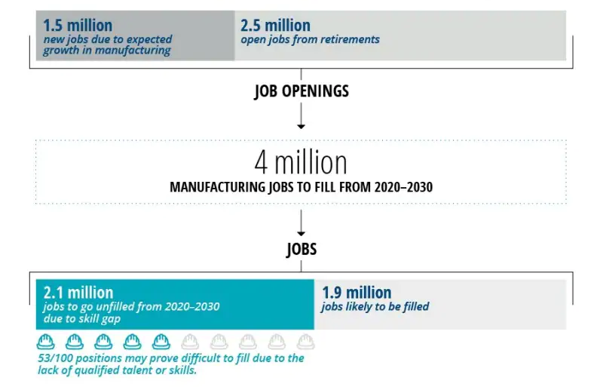
Challenge 4: Manufacturing faces a workforce shortage
Manufacturers increasingly have difficulty filling middle-skill jobs. Examples include computer numerical control (CNC) machinists, welders, and maintenance technicians. Without changes to the skills composition of the workforce, up to 2.1 million jobs could be left unfilled between 2020 and 2030, impacting productivity,innovation, competitiveness, and GDP
Role for cities : Workforce Development Strategies
Unlike entry-level jobs, middle-skill jobs require specific skills and knowledge that cannot be filled immediately with someone from another industry or recent high school graduates.
Cities need to invest in training programs that provide hands-on experience and practical skills development.
Source: Deloitte Insights. "The Skills Gap in US Manufacturing: Getting Entry-Level Employees in the Door."

Slide 33
Contents
An Economy in Transition
A Distributed Geography of Production
Upcoming Challenges & The Role of Cities
Early Policy Signals
What comes next?

Slide 34
This shift leaves much at stake for American cities
Upcoming Challenges
Role for cities
Industrial Sprawl
Spatial Mismatch
Minority firms underrepresentation
Skilled workforce shortage
 | Attract suppliers
 | Ground dispersed industries
 | Regional Coordination
 | Supplier development
 | Workforce development
Source: Nowak Metro Finance Lab.

Slide 35
There are early policy signals of cities and metros leveraging their distinctive strengths through intentional industrial investments and initiatives
 | 1 | 2 | 3 | 4 | 5 | 6 | 7 | 8
Goal | Matching funding to worthy projects | Prepare sites for mfg | Upgrade Capacity/ Technology | Ensure long-term economic competitiveness | Preparing for the ongoing talent shortage | Securing opportunities for small, diverse firms | Upgrade Logistics | Unlock the full ecosystem
Tool | Investment Playbook | Assembly and Remediation | Industry 4.0 | Applied Research | Workforce Development | Supplier Development | Infrastructure | Industry Hubs
Example | Industrial playbook in Flint, MI | Port Authority Industrial Revitalization in Cincinnati, OH | Mfg Readiness Grants in Indianapolis, IN | Advanced Manufacturing Innovation Center in St. Louis, MO | Northland Workforce Training center in Buffalo, NY | Aerospace and Defense Manufacturing coalition in El Paso, TX | Offshore Windport in Rhode Island | Aerospace and Defense Cluster in Wichita, KS
Source: New Localism Associates.

Slide 36
Early signals from across the country: Industrial Playbook in Flint, MI
Five major investments could set Flint on a new path by providing the region with a niche in the new E.V. supply chain and ensuring Flint grows a new local industry and rebuilds its city in parallel.
Macro Shift(s) |  | Local Assets |  | Proposed Investment |  | Total Cost | State Request
The Electrification of the Auto Industry | + | Infrastructure and Access to the Auto Supply Chain, Leading STEM Co-op University | → | 1 | New Center of Excellence: Advanced Closed-Loop EV Battery Recycling Commercialization Center (ACLEV) | $115M | $100M
The skilled worker shortage | + | A unique spectrum of post-secondary institutions | → | 2 | Flint Initiative for Talent (FIT) | $10M | $5M
The reshoring of manufacturing, the electrification of the auto industry, and the Skilled worker shortage | + | Flint’s unique post-secondary institutions | → | 3 | Innovation Voucher Pilot | $4M | $3.75M
The Reshoring of Manufacturing | + | Cheap land and water and strong infrastructure | → | 4 | Industrial Action Team (IAT) | $33M | $20M
To prepare Flint for its upcoming growth and tie the investments together |  |  | → | 5 | Flint Place-Making Fund | $150M | $50M
 |  |  |  |  | TOTAL | $317M | $188.75M
Source: New Localism Associates.

Slide 37
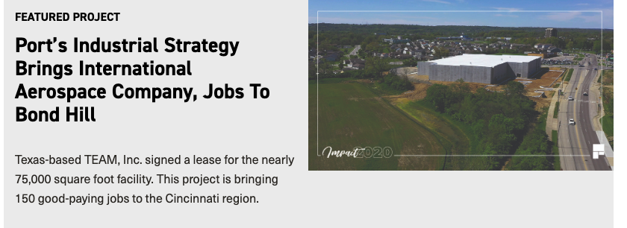
Early signals from across the country: Port Authority Industrial Revitalization in Cincinnati
Site Readiness Strategy: Acquisition, demolition, and site preparation of sites for business retention and expansion, addressing vacant historic manufacturing corridors.
Site Readiness strategies are supported by the Port’s engagement in environmental remediation services and collaboration with state/federal agencies for project development.
Source: Cincinnati Port Authority. Site Readiness.

Slide 38
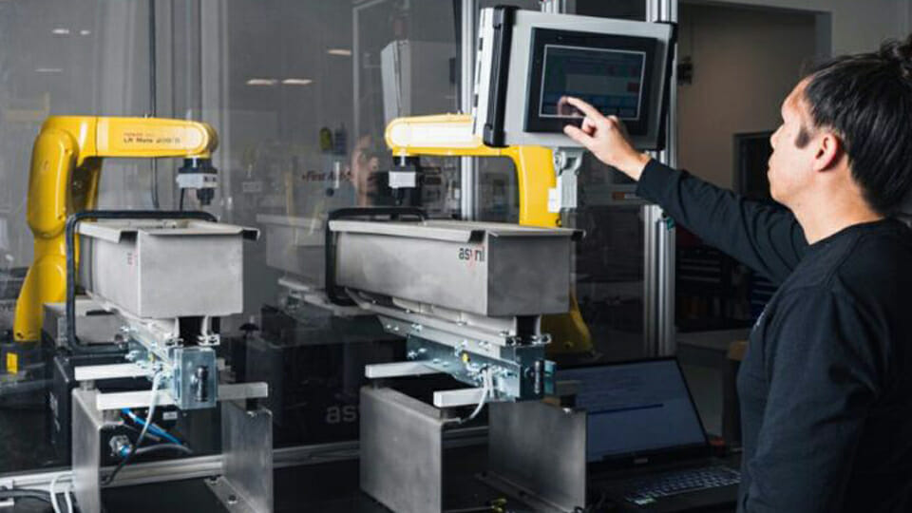
Early signals from across the country: Manufacturing Readiness Grants in Indiana
“Indiana’s rich manufacturing history paired with these new investments will ensure that Indiana continues to lead as the world transitions into Industry 4.0”
-Brad Chambers, Indiana Secretary of Commerce, Feb 2023
Goal: stimulate private sector investments to modernize Indiana's manufacturing industry.
Since its inception in 202o, the program has awarded a total of 384 grants worth $39 million to companies in 69 counties, with proposed projects totaling $484 million.
Grant recipients have reported positive impacts, including the adoption of smart manufacturing technologies, creation of new jobs, and anticipated revenue growth.

Slide 39
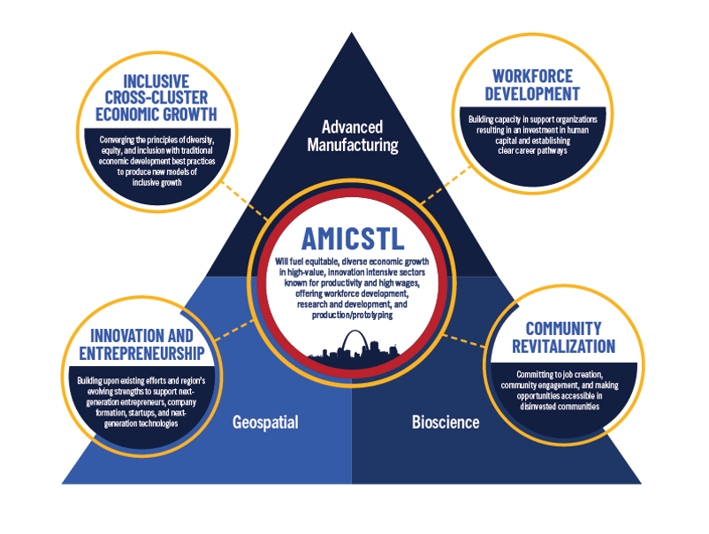
Early signals from across the country: Advanced Manufacturing Center in St. Louis
The St. Louis Tech Triangle, a corporate-created innovation district recently won $25M from the Build Back Better Regional Challenge to promote advanced manufacturing and build out the 130,000 square-foot Advanced Manufacturing Innovation Center.
Centers like these are emerging across the country to reshore production.
Source: New Localism Associates.

Slide 40
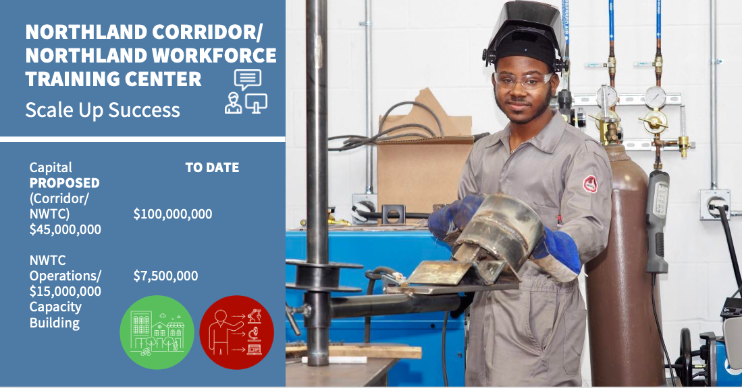
Early signals from across the country: Northland Workforce Training Center
The Northland Workforce Training center is public-private partnership between employers, educational institutions, community and faith-based organizations and state and local government
Goal: Closing the skills gap of the local labor pool and creating economic on-ramps to training, co-ops, internships, apprenticeships, and permanent employment for Western New Yorkers seeking high-paying advanced manufacturing and energy careers.
Source: Nowak Metro Finance Lab.

Slide 41
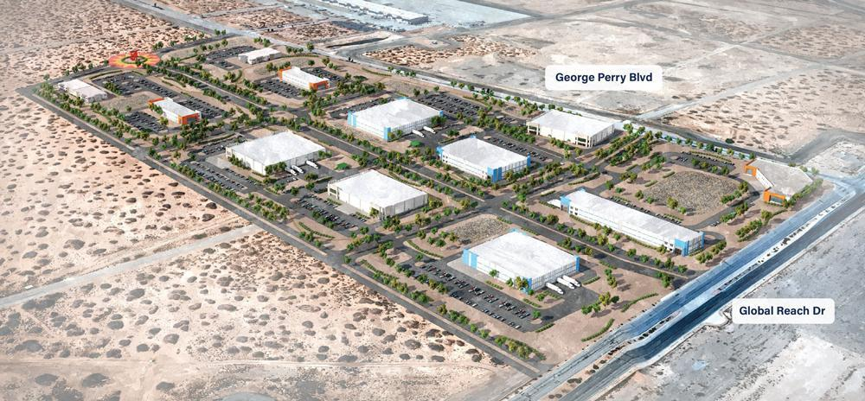
Early signals from across the country: Aerospace and Defense Manufacturing in El Paso
Through approximately $40M from BBBRC, the West Texas Aerospace and Defense Manufacturing coalition, led by the University of Texas at El Paso, will establish the El Paso Makes Advanced Manufacturing District where small- and mid-size firms can co-locate with research and innovation assets while also benefiting from the physical and cybersecurity infrastructure.
Through their initiative El Paso is integrating Latino firms into their growing and competitive industries.
Source: New Localism Associates.

Slide 42
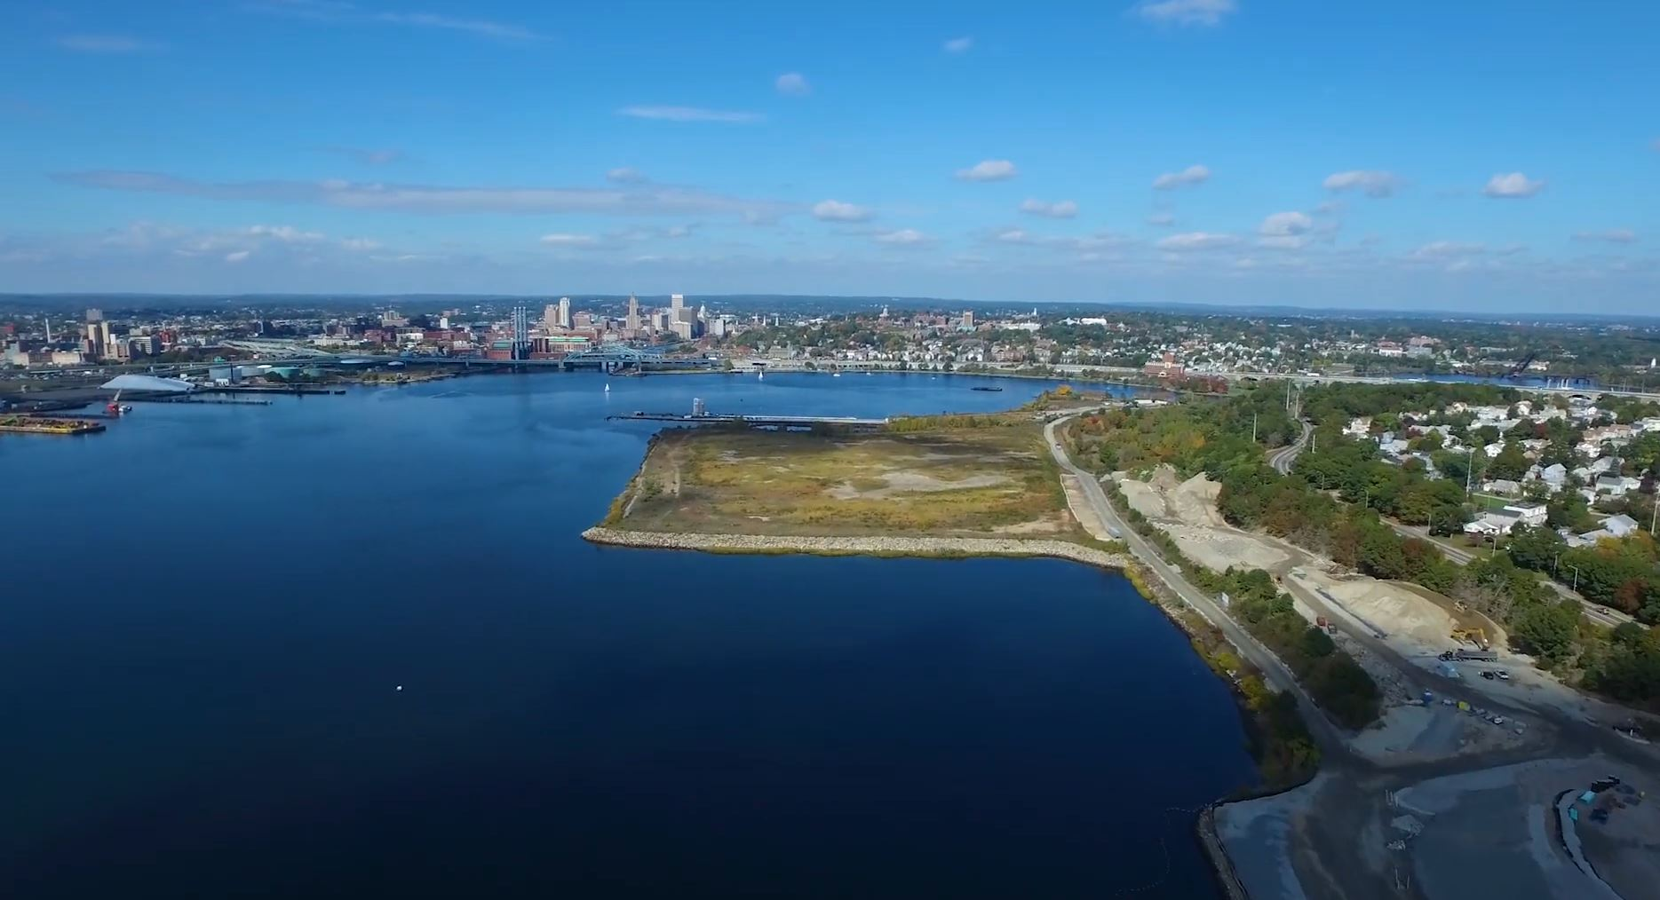
Early signals from across the country: Offshore Windport in Rhode Island
Rhode Island is using $35 million in funding from the American Rescue Plan to start a wind port project at South Quay Marine Terminal.
Rhode Island aims to become a regional hub for the offshore wind industry in the Northeast, with South Quay located strategically to serve the Massachusetts and New York Wind Lease areas
Port infrastructure capable of supporting offshore wind activities is currently limited in the U.S., with investments underway at several ports along the Eastern Seaboard to address this.
The 33-acre riverfront parcel created in 1976 by the Providence Worcester Railroad will soon contribute to the offshore wind industry.

Slide 43
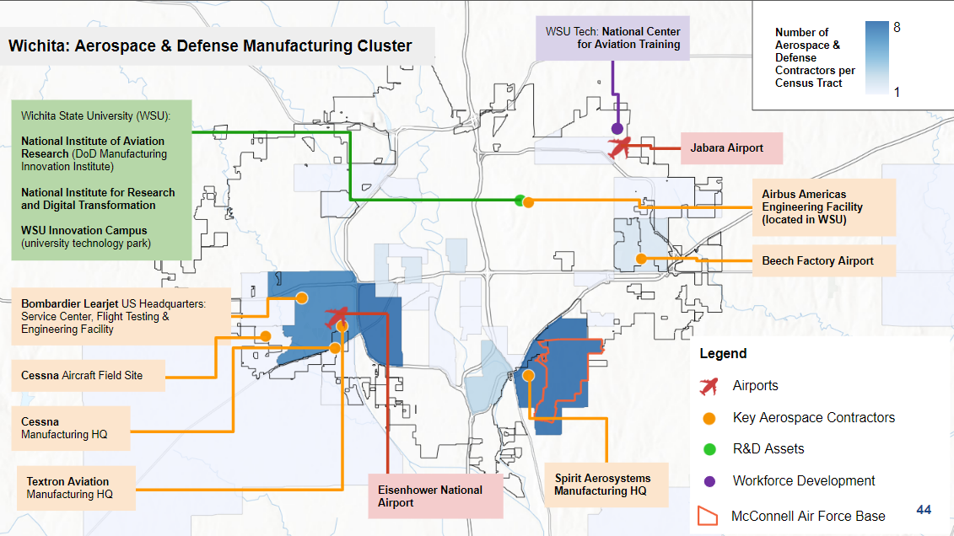
Early signals from across the country: Aerospace & Defense Manufacturing Cluster in Wichita
Assessing their geography of production helps metros identify the assets they can leverage
Cities like Wichita unsurprisingly have an advanced starting point within their manufacturing cluster.
Through decades-long investment in aerospace infrastructure and strategic R&D assets, Wichita grounds itself among an otherwise dispersed industry.
Metro areas cultivating next-generation industries need to figure out how to use their urban assets to do the same.
Source: Nowak Metro Finance Lab; Aerospace and Defense contractors were identified from Data Axle 2023, using NAICS 3364

Slide 44
Contents
An Economy in Transition
A Distributed Geography of Production
Upcoming Challenges & The Role of Cities
Early Policy Signals
What comes next?

Slide 45
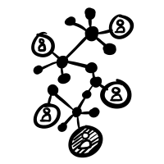
Cities need to adapt to these mega forces, understand their starting points and design and deliver strategies to maximize inclusive growth
Metros can:
Align federal investments with distinctive aspects of a community
Layer investments in same geography
Leverage private, public, and civic resources
Metros:
Have disproportionate economic impact
Are on the front lines of economic shifts
Have considerable spending power
Are Horizontally Integrated
Have Market Relevance
Metros
Metros can “think like systems and act like entrepreneurs”
-Matthew Taylor, former head of the Royal Society of Arts
"Power is shifting downward from national governments to cities and communities; horizontally from the public sector to networks of public, private and civic actors; and globally along circuits of capital, trade, and innovation.
New Localism is the twenty-first century’s means of solving the problems characteristic of modern life.”
-The New Localism, Bruce Katz and Jeremy Nowak
Have Networked Power
Metros have:
Multiple layers of power and authority
Bring together public, private, and civic leaders
Source: New Localism Associates.
Notes:
https://www.whitehouse.gov/briefing-room/statements-releases/2022/02/24/the-biden-harris-plan-to-revitalize-american-manufacturing-and-secure-critical-supply-chains-in-2022/

Slide 46
We have been planning the post-industrial city for decades
We need to deliver the industrial metropolis
What’s your industrial edge?
Who is in your ecosystem?
Who are the suppliers who need urban sized space?
What are your land possibilities?
What’s your innovation play?
What's your workforce imperative?
What’s your infrastructure strategy ?
What's your Small Business Opportunity?

Slide 47
Thank you!
Bruce Katz, Co-Founder and Director, Nowak Metro Finance Lab, Drexel University
Victoria Orozco, Director, Punto Lab.
Avanti Krovi, Research Officer, Nowak Metro Finance Lab,Drexel University.
Milena Dovali Delgado, Research Officer, Nowak Metro Finance Lab,Drexel University.
April 2023

